Slide 1
Tech Initiative Update slides

Slide 2
Update on Technology Initiative
Our Goal:
To become an important source of technology education for
People seeking to move into a technology career
Working professionals seeking additional skills and credentials
Our Approach:
Offer training in a variety of non-credit and credit bearing formats that addresses evolving technology topics and skill sets in formats that meet the scheduling needs of our target audience

Slide 3
Update on Technology Initiative
Current Status
We are developing:
Curriculum
Infrastructue
Effective Marketing Campaign

Slide 4
Update on Technology Initiative
Curriculum
Stackable graduate certificates in Business and Computer Science
Stackable undergraduate certificates in SCPS
Non-credit professional training in SCPS
Next up: Bootcamps
Infrastructure
New web presence (roll-out in late October)
New B2B corporate marketing unit
Working professional scheduling, plus expanded on-line

Slide 5
Update on Technology Initiative
Effective Marketing Campaign
In development, with funds from Enrollment Management and special fund (“AIT”)
Brand and program-specific marketing

Slide 6
Computer Science Program Advisory Council (CSPAC) Meeting
September 25, 2019

Slide 7
Mentor/mentee guidance
Meetings from September 2019 – May 2020
8 - 9 meetings
Face-to-face, video conference, site visit, professional event
Duration (1 hour meeting, longer for site/shadow visit or professional event)
Suggested Phases
Beginning (3): Get to know each other, build trust, set expectations
Middle (4): Most productive, mutual trust and sharing of concerns, test/challenge ideas, strategize about career options and planning
Wrap-up (2): Formal relationship winds down, determine future contact
Suggested Checkpoints
What’s working well? What needs to be changed?
How do we feel about the structure, format, activities of our pairing?
What other topics/activities may be helpful that we haven’t tried?
Mid-Point and End of Year Survey
What to do if there is a mismatch?
Contact Bob Yacobellis or Susan Malisch
7

Slide 8
GUIDelines for Mentees
Own the relationship. Schedule the meetings.
Share an agenda.
Summarize the conversation and any actions; thank them for their time.
Schedule the next meeting.
Be reliable, respectful, grateful.
Mentors are busy. Use their time wisely. They may have to reschedule from time-to-time to meet business needs.
Things come up. Don’t be a no-show. Reschedule as a last resort.
Build your “diary” and reflection document.
Use your summaries.
Add your reflections.
8

Slide 9
GUIDelines for Mentors
Engage with your mentee
Be a resource.
Share your personal and professional experiences and advice.
You don’t have to have all the answers.
Ask questions. Listen.
Some Characteristics of Good Mentoring Relationships
(From “The Mentee’s Guide: Making Mentoring Work for You”, by Lois J. Zachary)
Reciprocity
Learning
Relationship
Partnership
Collaboration
Mutually defined goals
9

Slide 10
Suggested AGENDA for TODay’s initial meeting
Introductions
Share your personal/academic/professional story (5 min)
Share some hobbies and interests
Define your most important goals (10 min)
Share preferred contact information (5 min)
Schedule next meeting date/time/location (5 min)
Discuss possible agenda/topics if time (5 min)
(Mentees will be excused at the end of this session)
10

Slide 11
Mentor/mentee pilot matching
11

Slide 12


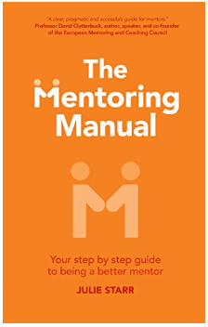
Resources
Lois J. Zachary – The Mentee’s Guide
Lois J. Zachary – The Mentor’s Guide
Julie Starr – The Mentoring Manual
12
Notes:
From The Mentoring Manual:
Idea One: Some things can be taught and others must be learned
Idea Two: While all journeys benefit from a sense of destination and purpose, no great adventure was ever planned in detail
Idea Three: Anything worth having is worth working for

Slide 13

COMPUTER SCIENCE STUDENT
ADVISORY COUNCIL

Slide 14
CS-STAC Purpose
CS-STAC is a representative body of students from undergraduate and graduate majors within the department convened to provide suggestions, reactions, insights, and opinions concerning department initiatives and services

Slide 15
Goals and Responsibilities
Improving the Computer Science department from within
Provide student perspectives on issues and activities under consideration by the administrative, academic, and service units within the department
Gather student feedback when requested
Show visible presence at department events, symposia, and talks

Slide 16
Accomplishments
Internal
Created CS-STAC website and Slack bots
Developing growth and familiarity within the council
Meeting regularly (~once/month)
Weekly discussions and regular communication
External
Conducted research on the tutoring services offered by CS department
Discussed potential improvements with CS faculty
Implementing improvements
Growing presence on Loyola’s campus
Bringing awareness to our council

Slide 17
CS-STAC 2019-2020 Focus
Create workshops focused around subjects students may find interesting outside of the classroom
Workshops on full stack development, ML, Git, Linux, data visualization, Agile/Scrum, pointers…
Partnering with local businesses and engineers
Develop a Computer Science Student Hub Blog
Student insight/testimonials
Classes, research, experience
Current events
Networking opportunities (events, internships, jobs, etc.)
Tutoring services
Resources

Slide 18
Making a Presence with CS-STAC
Attending networking events around Chicago
Connecting with professionals in the industry
Making our name known at Loyola

Slide 19


Slide 20
Goals
To provide an opportunity for young girls to learn to code as well as work to close the gender gap in computer science and related fields.
To inspire our students to try new things and expand their horizons in ways they may not have previously known about.
To build a network of support for both students and volunteers.

Slide 21
Student Involvement
Volunteers
Mentors and teachers
Student Fellows
Leadership roles
Paid positions using grant funding

Slide 22
Jay Wengrow
2x Loyola Alum
CEO, Actualize

Slide 23


Slide 24
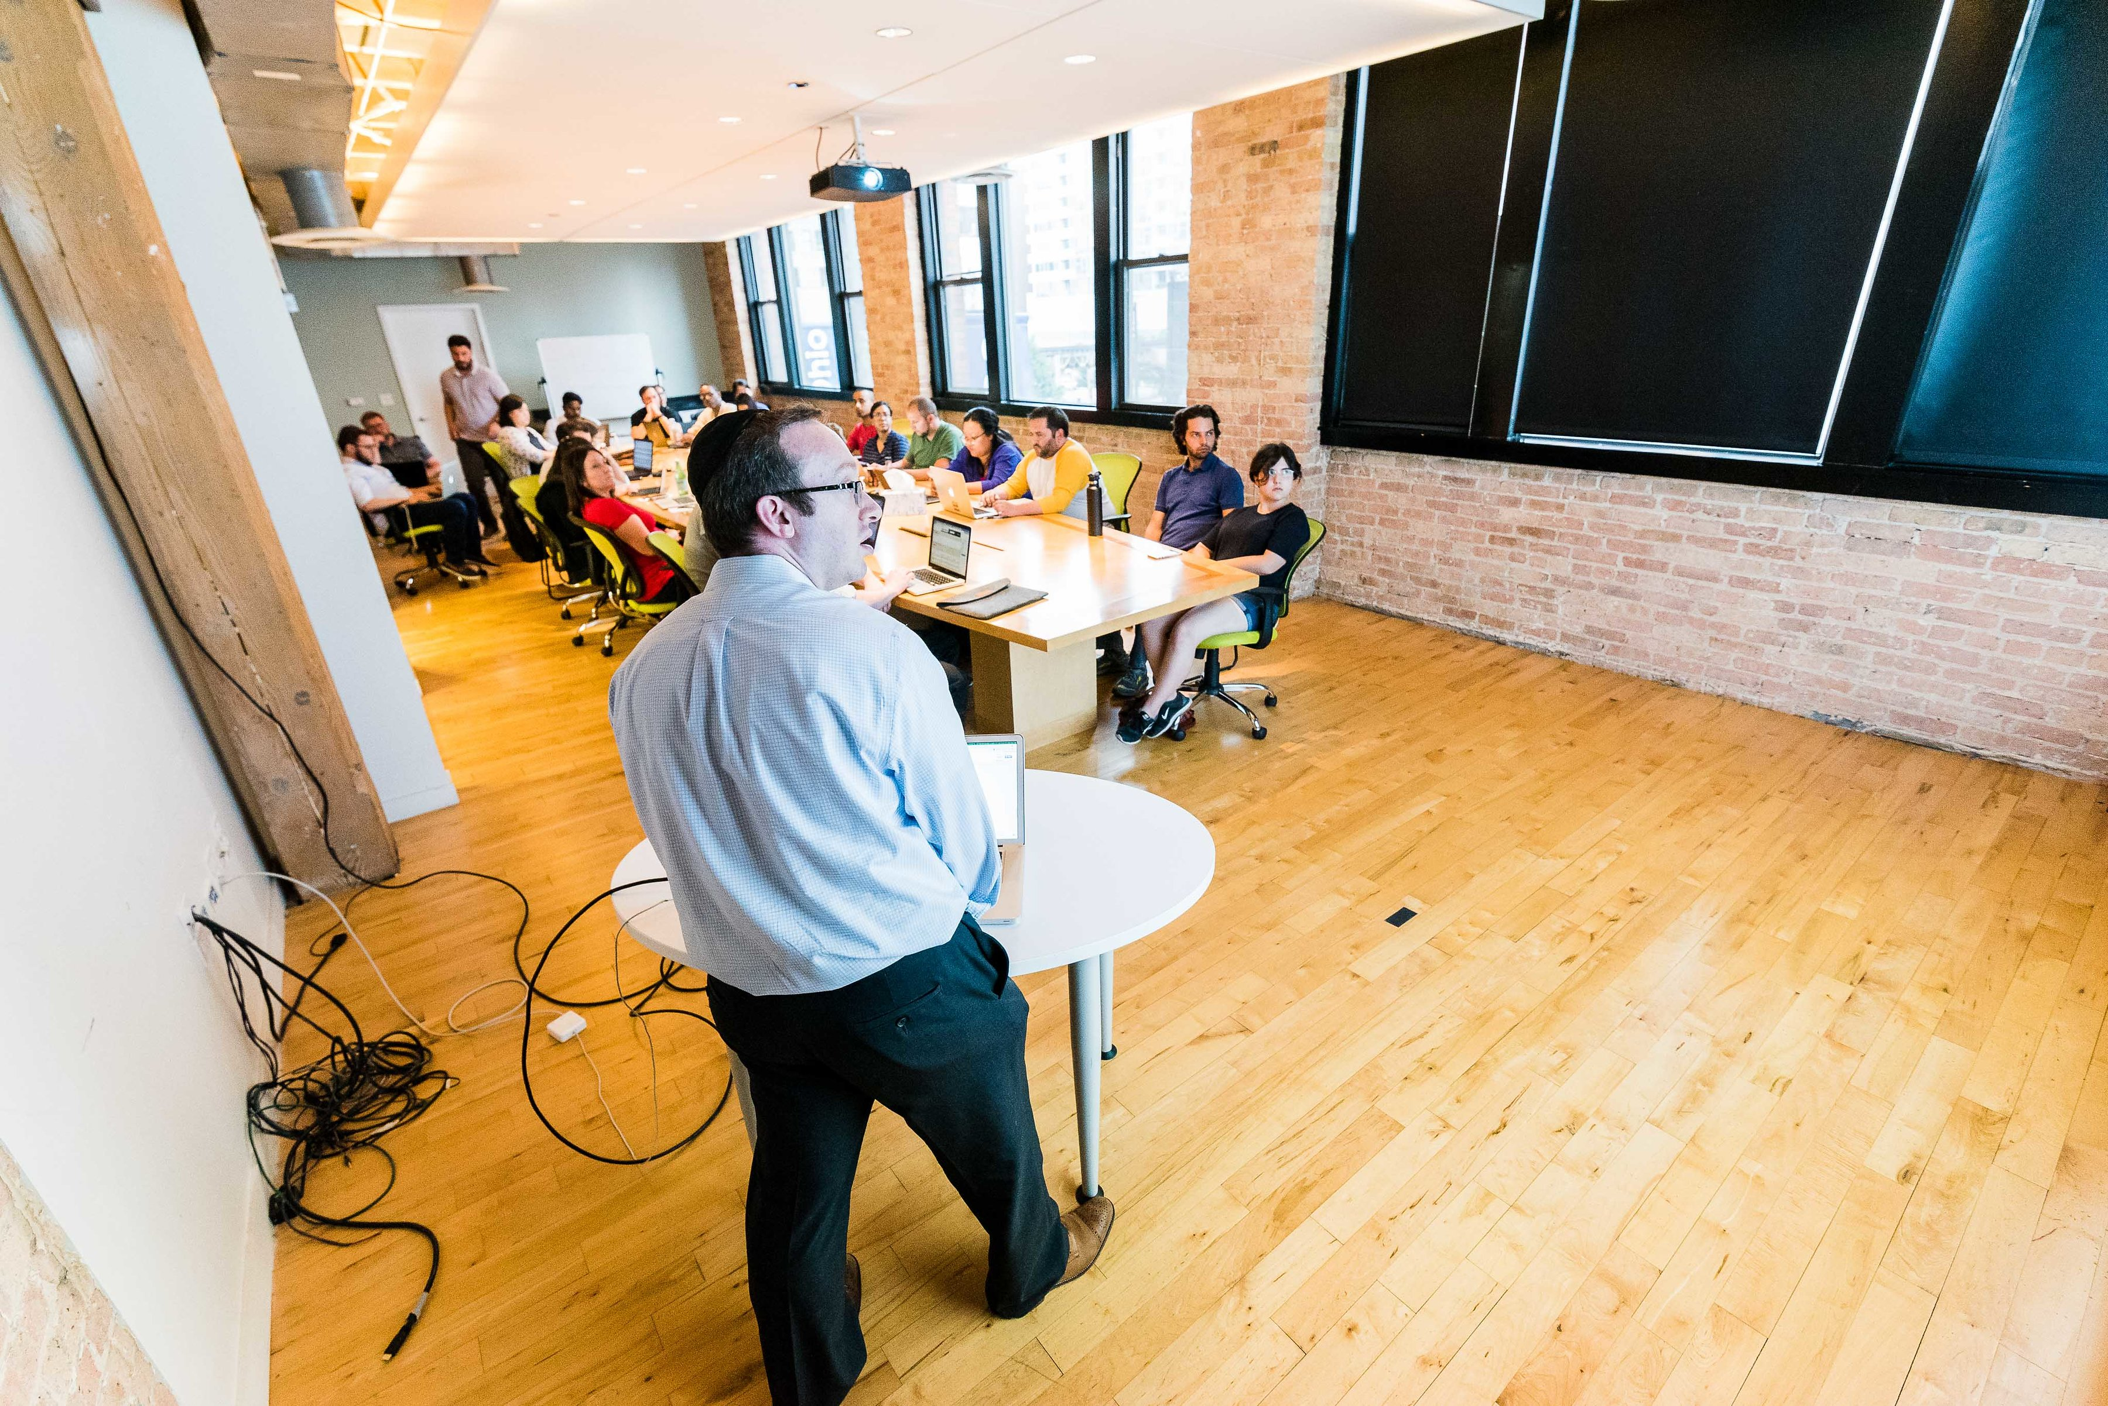

Slide 25


Slide 26
Sandbox Industries
Doggyloot
Apartments.com

Slide 27
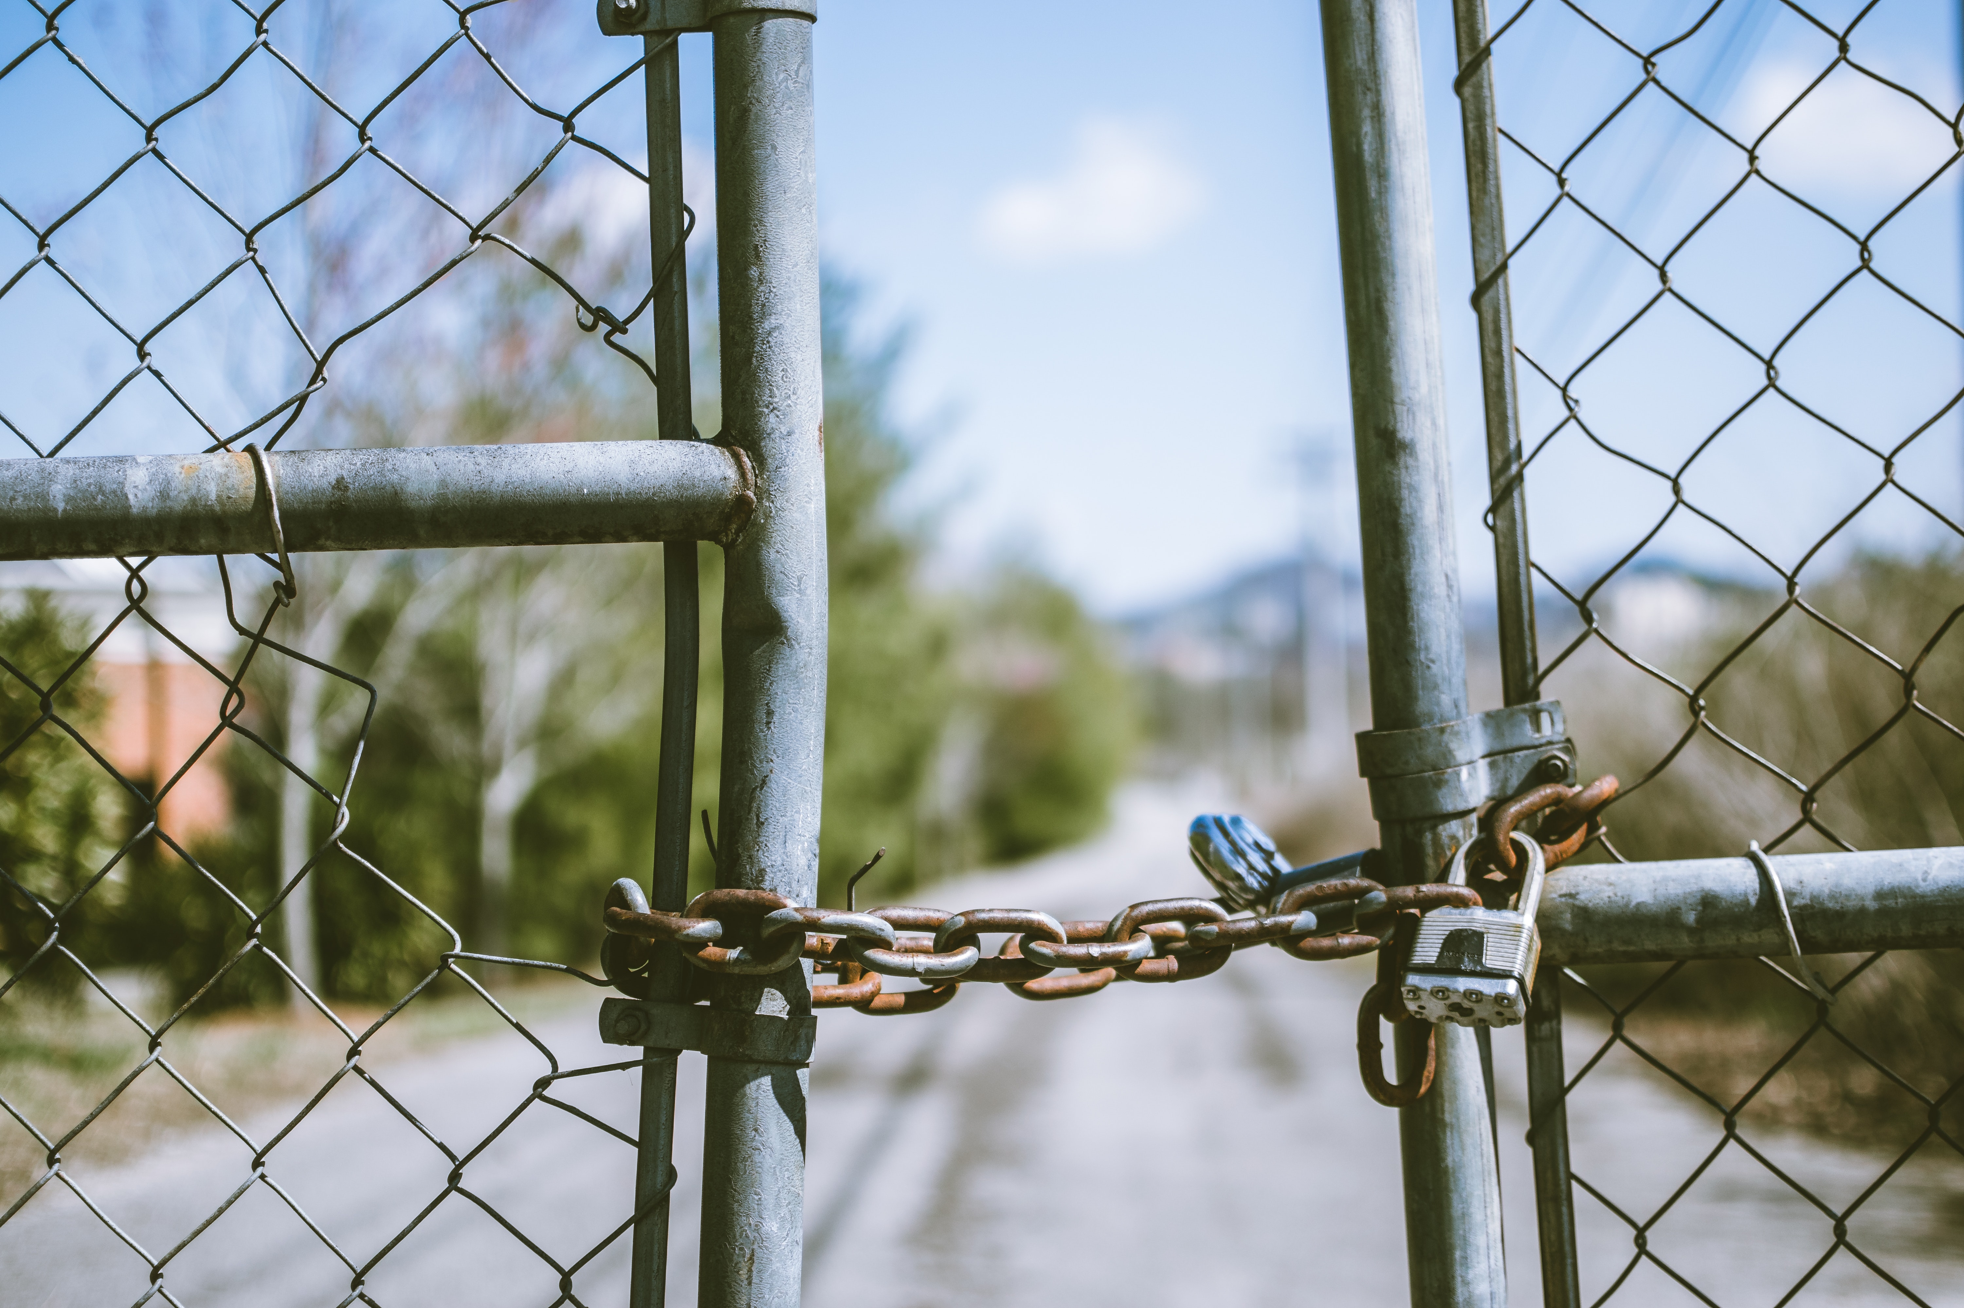

Slide 28


Slide 29
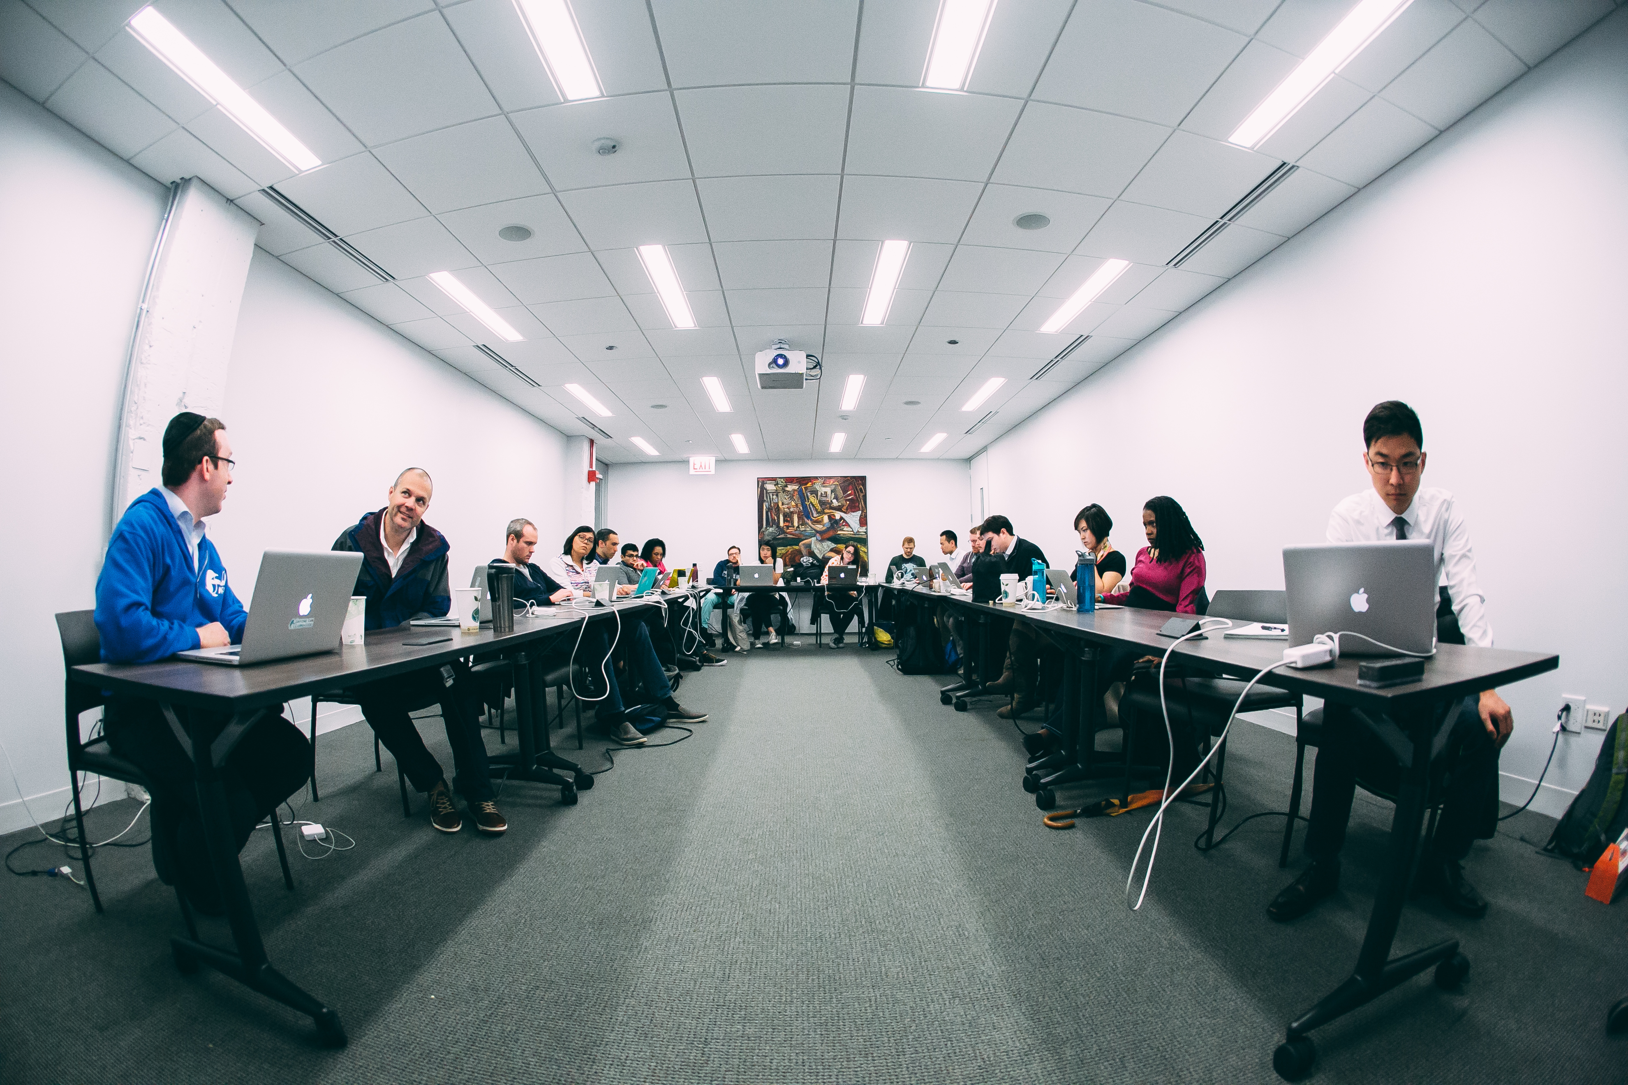

Slide 30
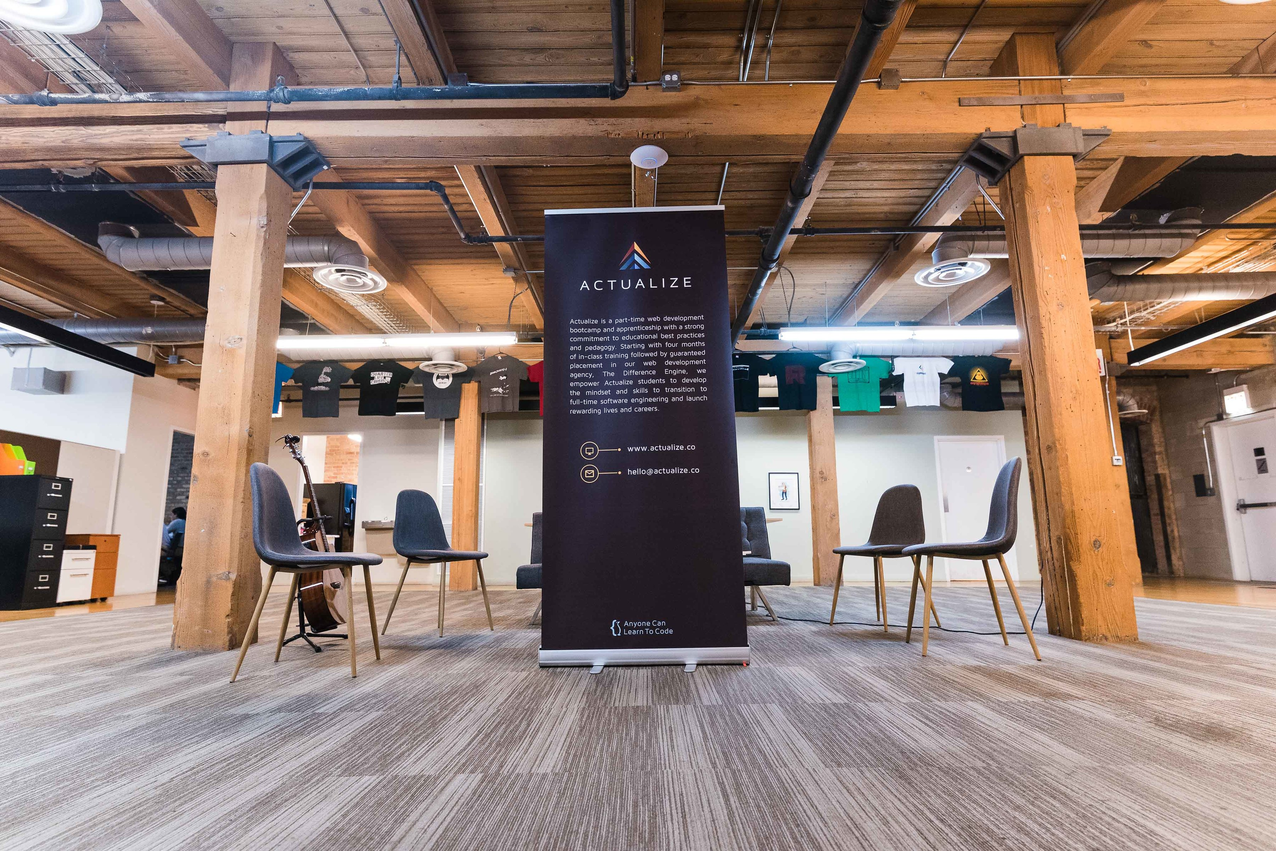

Slide 31
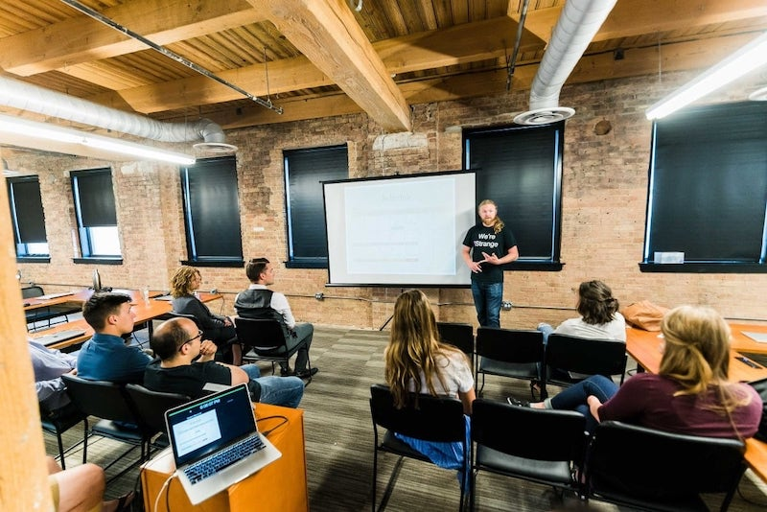

Slide 32
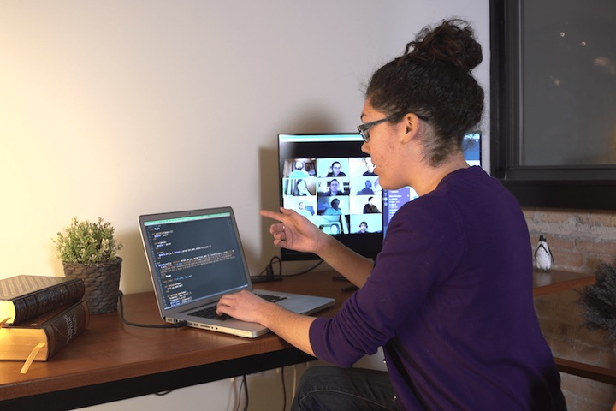

Slide 33
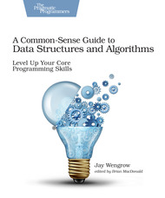

Slide 34
Opportunities & Challenges

Slide 35
Competitive Landscape

Slide 36
Questions?

Slide 37

Highlights Department of Computer Science 2018-2019

Slide 38
Department by Numbers (2018)
Full-time Faculty 14 FTE
Undergraduate majors/minors: 400
Graduate students: 80
Number of Graduates
(i) BS: 76
(ii) MS: 45

Slide 39
Faculty Highlights
Published Research Areas
Software and Systems, Big data, Security and Privacy, Bioinformatics, Machine Learning, and Computer Science Education.
37 journal and conference publications
25 poster presentations and 6 invited talks
Research Grants
New Funding: $260K
Continuing Funding: $3.4 million
Funding Agencies: NSF, NIH, Kimberly Clark.

Slide 40
Student Engagement and Highlights
Student research: ~ 60% of the research publications co-authored with students.
Internships: ~ 50 internships : CNA, Bosch, SEC, NSA, and startups. .
Student Club Activities: Student Advisory Council, Girls Who Code, Don’t Panic, ACM, Cybersecurity, and Data Analytics.
Career Preparation: Students are being assisted by Sammy Corbett in addition to Loyola Career Services.

Slide 41
Programs and People
BS Data Science (jointly with Statistics) – fall 2019
Three post-bac Certificate programs
Dual credit offerings in two high schools.
Dr. Eric Chan Tin (Cybersecurity), fall 2018
Dr. Neil Klingensmith (IoT, architecture, operating systems), fall 2019.
Two new hires in fall 2020 (Machine learning, Systems)

Slide 42
Undergraduate Curriculum
Major Revisions in all undergraduate majors
Computer Science, Software Engineering, Cybersecurity will require 61 credits for graduation
Information Technology will require 50 credits.
Changes to Computer Crime and Forensics minor, Computer Science minor.
Changes to Bioinformatics, Data Science majors.

Slide 43
2020 plans
Marketing current programs
Graduate curriculum revisions
New Certificate Programs
New faculty hires
Strengthening student engagement

Slide 44
SCPS Updates – Udayan Das udas@luc.edu
New Certificate Programs (3 courses)
Fall 2019: Intro to Data Science Certificate
Coursework in Python, Python Data Toolkits, Databases & SQL, Data Processing and Visualization.
Spring 2020: Web Design & Development (WordPress)
Coursework in HTML/CSS, Design, Responsive Design, Content Management & Hosting, JavaScript, React
Awaiting Approval
Under development for Fall 2020: User Experience Design
Loyola University Chicago

Slide 45
SCPS Updates – Udayan Das udas@luc.edu
Non-Credit Workshops Fall/Spring
Cyber Incident Response Management
Che Bhatia, VP Cyber Resilience, Stroz Freidberg
December 10 & 11, 2019; March 23 & 24, 2020
Agile Software Development
Jessica Zuniga, Senior Agile Project Manager, Enova International
January 23 & 24, 2020; April 23 & 24, 2020
Cloud Security Architecture
Ammar Ahmed, Principal Architect, Cloud Technology Partners
Saturdays: February 22 & 29, 2020; June 6 & 13, 2020
Loyola University Chicago

Slide 46
SCPS Updates – Udayan Das udas@luc.edu
Non-Credit Workshops Summer/Fall 2020
Developing Workshops based on PAC feedback:
Infrastructure-as-code
Design Thinking (need support)
Technology Ethics
Please refer Workshop Topics/Ideas, Potential Instructors/Presenters, other feedback to SCPS (Udayan)
SCPS subcommittee meeting in the Spring can be dedicated to Workshops
Loyola University Chicago

Slide 47
Concluding remarks
Thank you Optum!!

